Slide 1

Tensilica Xtensa
Tuan Huynh, Kevin Peek & Paul Shumate
CS 451 - Advanced Processor Architecture
November 15, 2005

Slide 2

Overview
Background
Changes in progress from Xtensa to Xtensa LX
Automated Development Process
ISA
TIE Language
Benchmarks

Slide 3
Tensilica
Founded in 1997 in Santa Clara, California by a group of engineers from Intel, SGI, MIPS, and Synopsys to compete with ARC
Goal: To address application specific microprocessor cores and software development tools by designing the first configurable and extensible processor core
Notes:
Extensible Processor – whose functions, especially its instruction set, can be extended by the application developer to include features never considered by the original processor designers
Can include instructions, execution units, registers never consider at original design
Configurable Processor:

Slide 4
Why?
Embedded application problems with high cost custom designs or low performance (inefficiencient) processors
System on a Chip (SoC) challenge
  Traditionally solved using hardwired RTL blocks

Slide 5
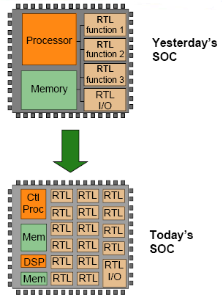
The Problem with RTL
Rapidly increasing number of transistors require more RTL blocks on chip
Hardcoded RTL blocks are not flexible
Hand-optimized for application specific purposes

Slide 6
Tensilica’s Solution
Xtensa
  Focusing on design through the processor, and not through hardwired RTL

Slide 7
Xtensa
First appearing in 1999
32-bit microprocessor core with a graphical configuration interface and integrated tool chain
Designed from the start to be user customizable
Emphasizes instruction-set configurability as its primary feature distinguishing it from other core offerings
Has revolutionized the System on a Chip (SoC) challenge through out its development
Configurable and Extensible

Slide 8
Xtensa – In a Nutshell
Enables embedded system designers to build better, more highly integrated products in significantly less time
Can add specialized functions or instructions to processor and have them recognized as “native” by the entire software development took chain
Move to a higher level of abstraction by designing with processors rather than RTL
Notes:
Offered to customer as synthesizeable RTL cores – VHDL represented control

Slide 9
Xtensa - Deliverables
Provided as synthesizable RTL cores
  Gate count range: 25,000 – 150,000+
  Increase in gates as customer adds instructions or optional features
Software development tools

Slide 10
Xtensa – Verification Challenges
To extensively verify the configurable processor to ensure each possible configuration will be bug free
To enable the customer to rapidly integrate the core while limiting support costs
Notes:
Discuss later in verification and O-In discussion

Slide 11
Xtensa – Basic Architecture
78 instructions
five-stage pipeline that supports single-cycle execution
1 - load/store model
32-entry orthogonal register file
32 optional extra registers

Slide 12
Xtensa – Basic Architecture
Processor Configuration
  Power Usage: 200mW, 0.25 μm, 1.5V
  Clock Speed: 170 MHz
  Cache:
    16 KB I-cache
    16 KB D-cache
    Direct mapped
  32 Registers (32-bits)
  Extensible via use of TIE instructions
  No Floating Point Processor
  Zero over head loops

Slide 13
Xtensa - ISA
Priorities used in ISA Development
  Code Size, Configurability, Processor Cost, Energy Efficiency, Scalability, Features
ISA Influences
  MIPS
  IBM Power
  Sun SPARC
  ARM Thumb
  HP Playdoh
  DSPs

Slide 14
Xtensa III
With Virtual IP Group developed an MP3 audio decoder for Tensilica's Xtensa configurable microprocessor architecture. The decoder offers hardware extensions and optimized code for accelerating MP3 decoding
32-bit floating point processing
32x32-bit hardware multiplier
First Coprocessor interface
  Vectra DSP enhancements
Notes:
$350,000. With the Vectra DSP option, the single instance fee is $500,000.

Slide 15
Xtensa IV
Used white box verification methodology for the original development
Includes 0-In Check and the CheckerWare Library made by Mentor Graphics
Could repartition instructions up until point of manufacturing
Support multiple processors in ASIC
128-bit wide local memory interface
Notes:
- The Mentor Graphics O-In Verification Business Unit tools were able to integrate seamlessly into Tensilica’s highly configurable verification environment.
- The checkers reduce core integration time, chiplevel verification time, and cost of support for Tensilica
-ASIC – application specific integrated circuit
Single-use licenses start at $350,000

Slide 16
Xtensa V
350MHz (synthesized), as small as 18K gates (0.25mm2)
More flexible interfaces for multiple processors
  Write-back and write-through caches
  Enhanced Xtensa Local Memory Interface
  Shared data memories
More Automation
  Xtensa C/C++ Compiler & TIE Language improvements
  XT2000 Emulation kit
World’s fastest embedded core
Notes:
Xtensa V processor delivers performance that is from 40 percent better to nearly 8.5X that of any other competitor on each of the four tests using a standard "Out-of-the-box" processor configuration. When optimized versions of the Xtensa V processor were tested, the results were up to 33X the closest competitor
In some cases, the Xtensa core outperforms even full-chip, multi-million- transistor standalone processor ICs that are as much as 100 times the size of the Xtensa core,
EDN: Top Product of the Year

Slide 17
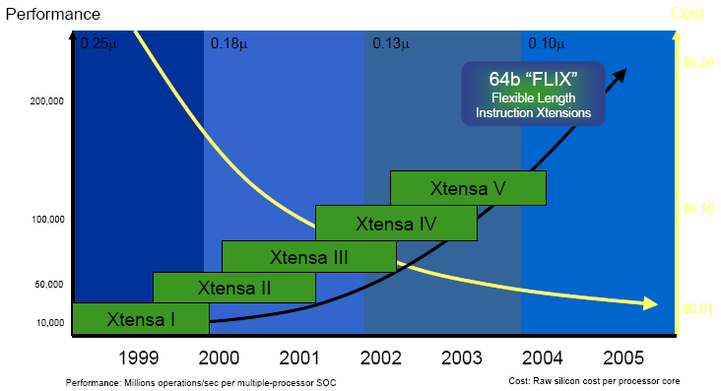
Xtensa V – Performance Cost Timeline
Notes:
Steady increase in performance while a steady decrease in costs. The 64b FLIX instructions expected in the future at this point will later prove to meet all expectations of performance enhancements and cost cuts

Slide 18
Xtensa 6
Extremely fast customization path
Three major enhancements from Xtensa V
  Auto customize processor from C/C++ based algorithm using XPRES Compiler
  30% less power consumption
  Advanced security provisions in MMU-enabled configurations

Slide 19
Xtensa LX
“Fastest processor core ever” – Tensilica
  I/O bandwidth, compute parallelism, and low-power optimization equivalent to hand-optimized, non-programmable, RTL-designed hardware blocks
  XPRES Compiler and automated process generator
  Uses Flexible Length Instruction Xtension (FLIX)
  Ideal for:
    embedded processor control tasks
    Compute-intensive datapath hardware tasks
Notes:
FLIX is a huge addition to the processor, in that is allows for designer defined optimized opcode sizes that work with the standard 16 and 24 bit instructions

Slide 20
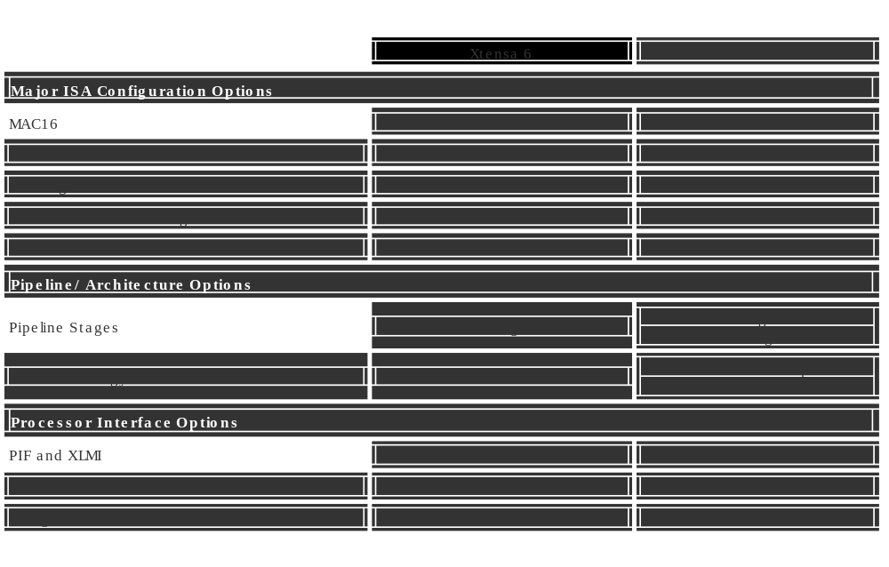
Xtensa 6 Vs Xtensa LX
Notes:
Since many similarities, we’ll be just discussing the details of Xtensa LX to avoid redundancy. However, these are a few key differences

Slide 21
Xtensa LX
Strongest selling point is performance
DSP operations can be encapsulated into custom instructions
High performance leads to power savings
Custom instructions target a special application

Slide 22
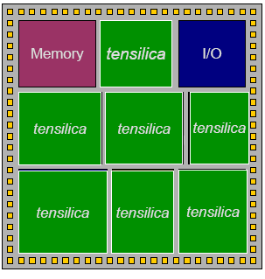
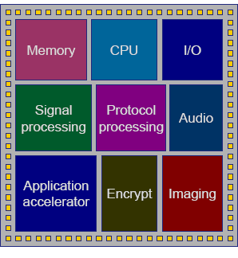
Xtensa LX Vs General Purpose
Notes:
Less wasted silicon for broad functionality is not needed
If able to run same speed – then can be much much smaller

Slide 23
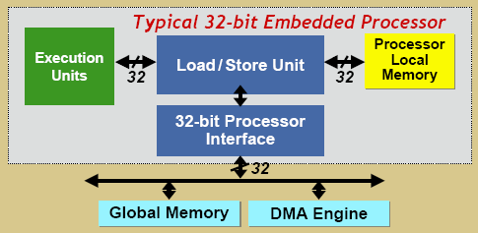
Xtensa LX – Traditional Limitations
1 Operation / cycle
Load/Store overhead
Notes:
Goals – higher band

Slide 24
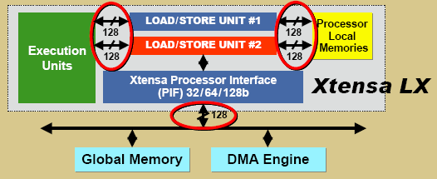
Xtensa LX
Options:
  Extra load/store unit, wide interfaces, compound instructions
Up to 19 GB/sec of throughput

Slide 25
Xtensa LX – Highlights
Lower power usage
I/O throughput at RTL speeds
Outstanding computer performance
XPRES Compiler

Slide 26
Xtensa LX – Lower Power Useage
Automated the insertion of fine-grain clock gating for every functional element of the Xtensa LX processor
  This includes functions created by the designer
  Direct I/O capability – like RTL
Notes:
The minimum configuration of the Xtensa LX processor dissipates a miserly 38 micro-W/MHz in a representative 130 nm process technology. By comparison, the smallest member of the ARM synthesizable processor family, the ARM7TDMI-S, burns 110 micro-W/MHz in 130 nm technology – twice the power consumption of the Xtensa LX.

Slide 27
Outstanding Computing Performance
Extensible using FLIX
  (Flexible Length Instruction Xtensions)
  Similar to VLIW – but customizable to fit application code’s needs
Significant improvement over competitors and previous Xtensa Design
  DSP instructions formed using FLIX to be recognized as native to entire development system
Notes:
The Xtensa LX processor’s innovative FLIX (Flexible Length Instruction Xtensions) architecture allows designers to pack multiple operations more efficiently into wider words.

Slide 28
XPRES Compiler
Powerful synthesis tool
  Creates tailored processor descriptions
  Run on native C/C++ code
Notes:
EXPLAINED LATER IN FLIX – analyzes code –makes suggestions

Slide 29
Automated Development
Clients log into website
  Accessing Process Generator
Builds a model in RTL Verilog or VHDL
  Sends result via internet to client’s site
Also receive:
  Preconfigured synthesis scripts, test benches, and software-development tools
Software tools include:
  Assembler, C/C++ compiler, linker, debugger, and instruction-set simulator already modified to match the hardware configuration
Notes:
Web-based tool w/ configurable options
series of pages with checkboxes, radio buttons, and menus.
can configure caches, buses, interrupts, and other microarchitectural features of the core.
also offers extension options, such as predefined instructions and the Vectra DSP unit.
real-time status display estimates the gate count, clock frequency, die area, and power consumption

Slide 30
Automated Development
Create special instructions described and written in TIE
TIE semantics allow system to modify software-development tools
Integrates changes into processor design
Compile with synthesis tool – test – order
Notes:
Update and seen as Native – everything works with new instructions, automatically

Slide 31
Xtensa LX – Basic Architecture
Processor Configuration
  Power Usage: 76 μW/MHz , 47 μW/MHz ( 5 and 7 stage pipeline)
  Clock Speed: 350 MHz, 400 MHz (5 and 7 stage pipeline)
  Cache:
    up to 32 KB and 1,2,3,4 way set associative cache
  64 general purpose physical registers (32-bits)
  6 special purpose registers
  Extensible via use of TIE and FLIX instructions
  Zero over head loops

Slide 32
Xtensa LX Architecture
32-bit ALU
1 or 2 Load/Store Model
Registers
  32-bit general purpose register file
  32-bit program counter
  16 optional 1-bit boolean registers
  16 optional 32-bit floating point registers
  4 optional 32-bit MAC16 data registers
  Optional Vectra LX DSP registers

Slide 33
Xtensa LX Architecture
General Purpose AR Register File
  32 or 64 registers
  Instructions have access through “sliding window” of 16 registers. Window can rotate by 4, 8, or 12 registers
  Register window reduces code size by limiting number of bits for the address and eliminated the need to save and restore register files

Slide 34
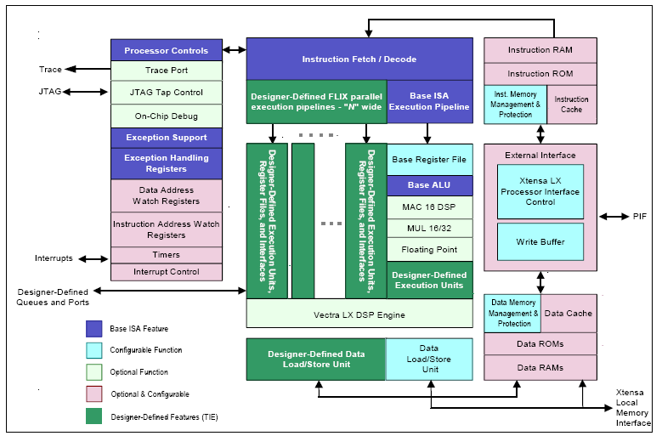
Xtensa LX Architecture

Slide 35
Xtensa LX Pipelining
5 or 7 Stage Pipeline Design
5 stage pipeline has stages: IF, Register Access, Execute, Data-Memory Access, and register writeback
5 stage pipeline accesses memory in two stages. 7 stage pipeline is extended version of the 5 stage pipeline with extra IF and Memory Access stage. Extra stages provide more time for memory access. Designer can run at a higher clock speed while using slower memory to improve performance

Slide 36
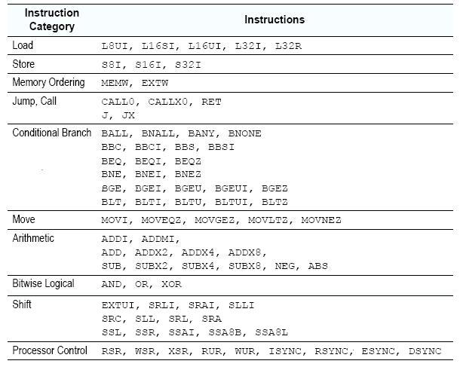
Xtensa LX Instruction Set
ISA consists of 80 core instructions including both 16 and 24 bit instructions
Notes:
EXTUI is extract unsigned immediate
ADDX2 – adds a register to a register shifted by 1
ADDX4 – adds a register to a register shifted by 2
ADDX8 – adds a register to a register shifted by 3
MEMW – Wait for any possible memory ordering requirement
EXTW – Wait for any possible external ordering requirement
BALL, BNALL, BANY, BNONE – Branch based on masked bits set
BBC, BBS – Branch if bit clear, Branch if bit set

Slide 37
Xtensa LX Instruction Set
Processor Control Instructions
  RSR, WSR, XSR
    Read Special Register, Write Special Register
    Used for saving and restoring context, Processing Interrupts and Exceptions, Controlling address translation
  RUR, WUR
    Access User Registers
    Used for Coprocessor registers and registers created with TIE
  ISYNC – wait for Instruction Fetch related changes to resolve
  RSYNC – wait for Dispatch related changes to resolve
  ESYNC/DSYNC – Wait for memory/data execution related changes to resolve
Notes:
RSR/WSR/XSR – Control read and write FROM the A[] register file to the special register SAR

Slide 38
Xtensa LX ISA – Building Blocks
MUL32
  MUL32 adds 32 bit multiplier
MUL16 and MAC16
  MUL16 adds 16x16 bit multiplier
  MAC16 adds 16x16 bit multiplier and 40-bit accumulator
Notes:
MAC16 – also adds 8 16-bit operand registers and special instructions to combine multiply and accumulate

Slide 39
Xtensa LX ISA – Building Blocks
Floating Point Unit
  32-bit, single precision, floating-point coprocessor
Vectra LX DSP Engine
  Optimized to handle Digital Signal Processing Applications
Notes:
Vectra DSP can triple physical size

Slide 40
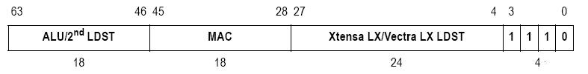
Vectra LX DSP Engine
FLIX-based (why it is 64 bits)
Vectra LX instructions encoded in 64 bits.
Bits 0:3 of a Xtensa instruction determine its length and format, the bits have a value of 14 to specify it is a Vectra LX instruction
Bits 4:27 – contain either Xtensa LX core instruction or Vectra LX Load or Store instruction
Bits 28:45 – contains either a MAC instruction or a select instruction
Bits 46:63 – contains either ALU and shift instructions or a load and store instruction for the second Vectra LX load/store unit

Slide 41
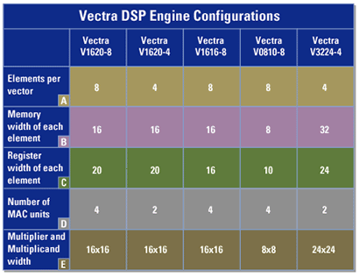
Vectra LX DSP Engine

Slide 42
Tensilica Instruction Extension
Method used to extend the processor’s architecture and instruction set
Can be used in two ways:
  For the TIE Compiler
  For the Processor Generator

Slide 43
Tensilica Instruction Extension
TIE Compiler
  Generates file used to configure software development tools so that they recognize TIE Extensions
  Estimates hardware size of new instruction
  You can modify application code to take advantage of the new instruction and simulate to decide if the speed advantage is worth the hardware cost

Slide 44
TIE
Resembles Verilog
More concise than RTL (it omits all sequential logic, pipeline registers, and initialization sequences.
The custom instructions and registers described in TIE are part of the processor’s programming model.

Slide 45
TIE Queues and Ports
New way to communicate with external devices
Queues: data can be sent or read through queues. A queue is defined in the TIE and the compiler generates the interface signals required for the additional port needed to connect to the queue. Logic is also automatically generated
Import-wire: processor can sample the value of an external signal
Export-state: drive an output based on TIE

Slide 46
TIE
TIE Combines multiple operations into one using:
  Fusion
  SIMD/Vector Transformation
  FLIX

Slide 47
Fusion
Allows you to combine dependent operations into a single instruction
Consider: computing the average of two arrays
unsigned short *a, *b, *c;
. . .
for( i = 0; i < n; i++)
c[i] = (a[i] + b[i]) >> 1;
  Two Xtensa LX Core instructions required, in addition to load/store instructions
Notes:
-Two short data items are added , and the result is shifted right by one bit.

Slide 48
Fusion
Fuse the two operations into a single TIE instruction
operation AVERAGE{out AR res, in AR input0, in AR input1}{}{
wire [16:0] tmp = input0[15:0] + input1[15:0];
assign res = temp[16:1];
}
  Essentially an add feeding a shift, described using standard Verilog-like syntax
Implementing the instruction in C/C++
#include <xtensa/tie/average.h>
unsigned short *a, *b, *c;
. . .
for( i = 0; i < n; i++)
c[i] = AVERAGE(a[i] + b[i]);
Notes:
- This instruction take two input values from the Xtensa core AR register file to compute the output value (res).
- Result is then put into the AR register file

Slide 49
SIMD/Vector Transformation
Single Instruction, Multiple Data
  Fusing instructions into a “vector”
  Allows replication of the same operation multiple times in one instruction
Consider: Computing four averages in one instruction
  The follwing TIE code computes multiple iterations in a single instruction by combining Fusion and SIMD
regfile VEC 64 8 v
operation VAVERAGE{out VEC res, in VEC input0, in VEC input1} {} {
wire [67:0] tmp = { input0[63:48] + input1[63:48],
input0[47:32] + input1[47:32],
input0[31:16] + input1[31:16],
input0[15:0] + input1[15:0] };
assign res = {tmp[67:52], tmp[50:35], tmp[33:18], tmp[16:1]};
}

Slide 50
SIMD/Vector Transformation
Computing four 16-bit averages
  Each data vector must be 64 bits (4 x 16 bits)
Create new register file, new instruction
  VEC - eight 64-bit registers to hold data vectors
  VAVERAGE - takes operands from VEC, computes average, saves results into VEC
  VEC *a, *b, *c;
  for (i = 0; i < n; i += 4){
  c[i] = VAVERAGE( a[i], b[i] );}
New Datatype recognized
  TIE automatically creates new load, store instructions to move 64-bit vectors between VEC register file and memory

Slide 51
FLIX
Flexible length instruction extension
  Key in extreme extensibility
  Huge performance gains possible
  Code size reduction without code bloat
Similar to VLIW
Created by XPRES Compiler

Slide 52
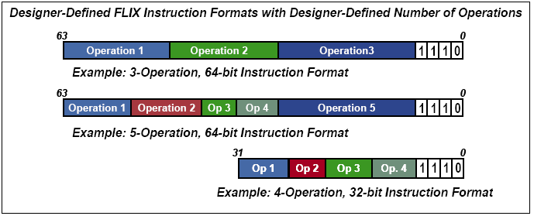
FLIX
Notes:
3 operation 64 bit FLIX
Etc
Note: as number of operations in a flix inst increase, number of bits avail to encode each decreases
General purpose instrs become more specialized because there are fewer bits available to specify source and destination operands and immediate values.

Slide 53
FLIX - Usage
Used selectively when parallelism is needed
Avoids code bloat
Used seemlessly and modelessly used with standard 16- and 24-bit instructions

Slide 54
XPRES Compiler
Powerful synthesis tool
  Creates tailored processor descriptions
  Run on native C/C++ code
Three optimizations methods
Returns optimal configurations along with pros and cons (tradeoffs)
Notes:
Compiler is a powerful synthesis tool that creates tailored processor descriptions for the Xtensa processors from native C/C++ code. Algorithm and systems designers can use the XPRES Compiler, in conjunction with Tensilica’s proven Xtensa Processor Generator technology, to synthesize highly optimized processor hardware RTL directly from C/C++ reference code or algorithmic specifications.

Slide 55
XPRES Compiler
Analyzes C/C++ code
Generates possible configurations
Compares performance criteria to silicon size (cost)
Returns possible configurations

Slide 56
XPRES Compiler - Results
Application dependent
  Compute intensive programs
  Data intensive programs
More is sometimes less
  operation slots in FLIX
Notes:
Having more encoding bits allows for making more comprehensive operations, requiring fewer operations per task.

Slide 57
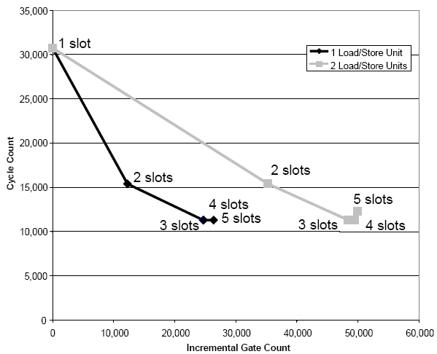
XPRES – 4 Program Test
“Bit Manipulator” program
Cut cycles to a third
Notes:
– places load, mask, shift, and store operations inside a loop. Can use increased operation parallelism to greatly increase performance.

Slide 58
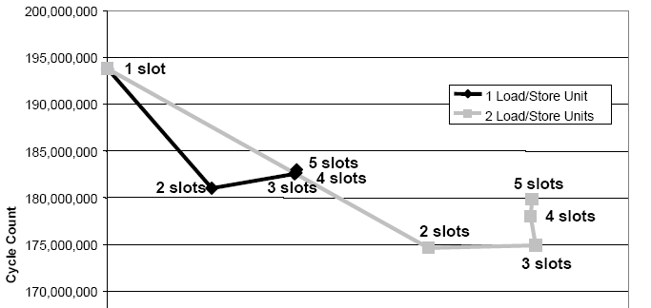
XPRES – 4 Program Test
H.264 Deblocking Filter
  6% performance improvement
Notes:
all from adding second load/store. Bottle neck here is load store / aka bandwidth or data transfer is a bigger deal
6% good since huge program

Slide 59
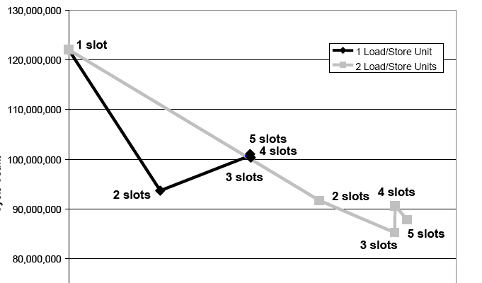
XPRES – 4 Program Test
MPEG4 decoder
  23% performance increase
Notes:
1 load/store, 2 operation slots
2 load/stores, 3 operation slots

Slide 60
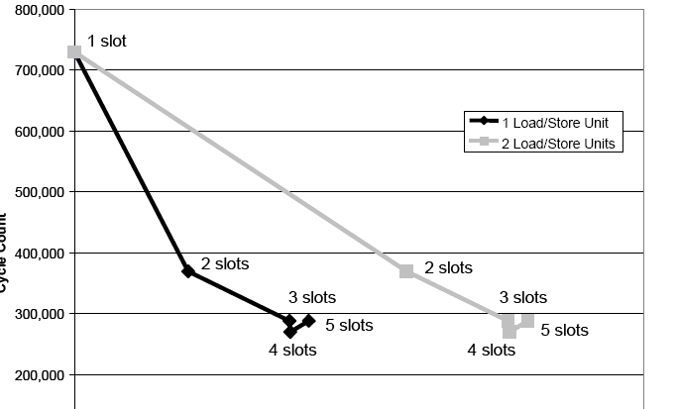
XPRES – 4 Program Test
SAD – sum of absolute difference
  63% performance increase
Notes:
63% cut in cycles at 3 slots – 2nd load store not worth it
similar increase as bit manipulator

Slide 61
Xtensa Hi-Fi 2 Audio Engine
Add-on package for Xtensa LX
Advantages over common audio processors:
  better sound quality of compressed files because of increased precision available for intermediate calculations. (24 bits rather than 16)
  24-bit audio fully compatible with modern audio standards

Slide 62
Xtensa Hi-Fi 2 Audio Engine
Audio packages integrated into an SOC design, so no additional codec development required
Integrated Audio Packages:
  Dolby Digital AC-3 Decoder, Dolby Digital AC-3 Consumer Encoder, QSound MicroQ, MP3 Encoder/Decoder, MPEG-4 aacplus v1 and v2 Encoder/Decoder, MPEG-2/4 AAC LC Encoder/Decoder, WMA Encoder/Decoder, AMR narrowband speech codec, AMR wideband speech codec.

Slide 63
Xtensa Hi-Fi 2 Audio Engine
Uses over 300 audio specific DLP instructions.
Features dual-multiply accumulate for 24x24 and 32x16 bit arithmetic on both units
“delivers noticeably superior sound quality even when decoding prerecorded 16-bit encoded music files. “

Slide 64
Speed-up Example
GSM Audio Codec – written in C
Profiling code using unaltered RISC architecture showed that 80% of the processor cycles were devoted to multiplication
Simply by adding a hardware multiplier, the designer can reduce the number of cycles required from 204 million to 28 million

Slide 65
Speed-up Example
Viterbi butterfly instruction
  Acts like compression for the data
  Consists of 8 logical operation
  8 of these operations are used to decode each symbol in the received digital information stream
  The designer can add a Viterbi instruction to the Xtensa ISA. The extension can use the 128-bit memory bus to load data for 8 symbols at once. This results in a average execution time of 0.16 cycles per butterfly. An unaugmented Xtensa LX executes Viterbi in 42 cycles.

Slide 66
EEMBC Networking Benchmark
Xtensa LX received highest benchmark ever achieved on the Networking version 2 test.
Xtensa LX has a 4x code density advantage and a 100x advantage in both die area and power dissipation

Slide 67
EEMBC Networking Benchmark
Normalized (per MHz) EEMBC TCPmark
Simulates performance in internet enabled client side performance
Processor | Score
Xtensa LX Optimized | 1.62434
PowerPC 760GX | 0.4671
PowerPC MCP7447A | 0.5856
Xtensa LX Out of the Box | 0.33762

Slide 68
EEMBC Networking Benchmark
Normalized (by MHz) EEMBC IPmark
Simulates performance in network routers, gateways, and switches
Processor | Score
Xtensa LX Optimized | 0.82138
PowerPC 760GX | 0.2861
Xtensa LX Out of the Box | 0.1818
PowerPC MCP7447A | 0.1751

Slide 69
EEMBC Networking Benchmark
Total Code Size
Processor | Total Size of Code
Xtensa LX Optimized | 65,208
Xtensa LX Out of the Box | 67,256
PowerPC 760GX | 255,764
PowerPC MCP7447A | 280,984

Slide 70
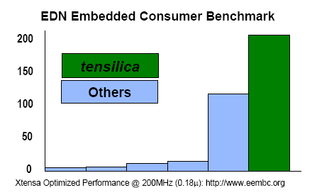

Slide 71
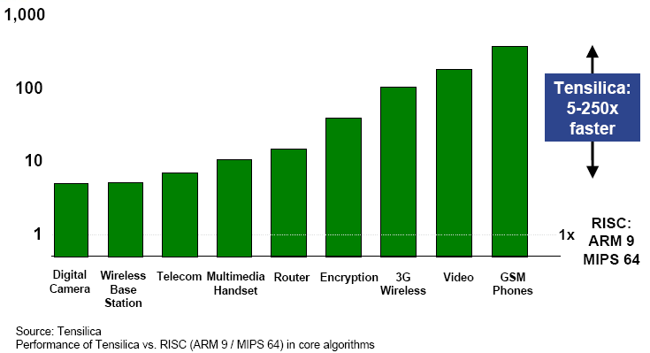
How Xtensa Compares

Slide 72
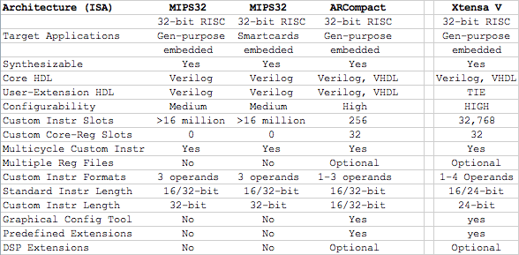
How Xtensa Compares

Slide 73
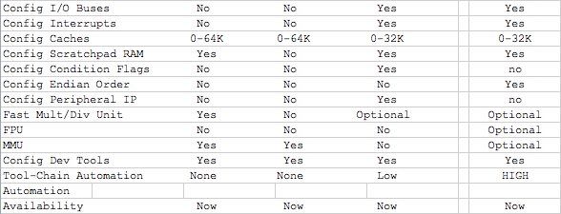
How Xtensa Compares (cont)
Notes:
It is said that if these companies were sculptors, MIPS would be delivering unpainted pottery, customizeable to a degree, while Xtensa and ARC offer raw clay, that you can do whatever you want with

Slide 74
Uses of Xtensa Products
NVIDIA – Licensed Xtensa LX
  “We were very impressed with Tensilica's automated approach for both the processor extensions and the generation of the associated software tools”

Slide 75
Uses of Xtensa Products
LG Cell Phone
  Phone is digital broadcast enabled
  Xtensa processor was used because it enabled LG to “cut design time significantly and be first to market with this exciting new technology.”
  Terrestrial digital-multimedia-broadcast system in Korea

Slide 76
In case you are wondering..
--Tensilica's announced licensees include Agilent, ALPS, AMCC (JNI Corporation), Astute Networks, ATI, Avision, Bay Microsystems, Berkeley Wireless Research Center, Broadcom, Cisco Systems, Conexant Systems, Cypress, Crimson Microsystems, ETRI, FUJIFILM Microdevices, Fujitsu Ltd., Hudson Soft, Hughes Network Systems, Ikanos Communications, LG Electronics, Marvell, NEC Laboratories America, NEC Corporation, NetEffect, Neterion, Nippon Telephone and Telegraph (NTT), NVIDIA, Olympus Optical Co. Ltd., sci-worx, Seiko Epson, Solid State Systems, Sony, STMicroelectronics, Stretch, TranSwitch Corporation, and Victor Company of Japan (JVC).

Slide 77
Questions?

